Slide 1

Theory of Production

Slide 2

DEFINITION OF PRODUCTION
Production is the process of transforming inputs into outputs.
INPUTS
Input refers to
the factors of production
that a firm uses in the production process
OUTPUTS
Refers to what we get at the end of the production process, that is, finished products.
Processing

Slide 3
CLASSIFICATION OF FACTORS OF PRODUCTION
All natural resources
or gifts of nature
LAND
LABOUR
Physical or mental
activities of human beings
CLASSIFICATION
OF FACTORS
OF PRODUCTION
A person who combines
the different factors of
production, and initiates
the process of
production and also
bears the risk
Part of man-made
wealth used for further
production
ENTREPRENEUR
CAPITAL

Slide 4
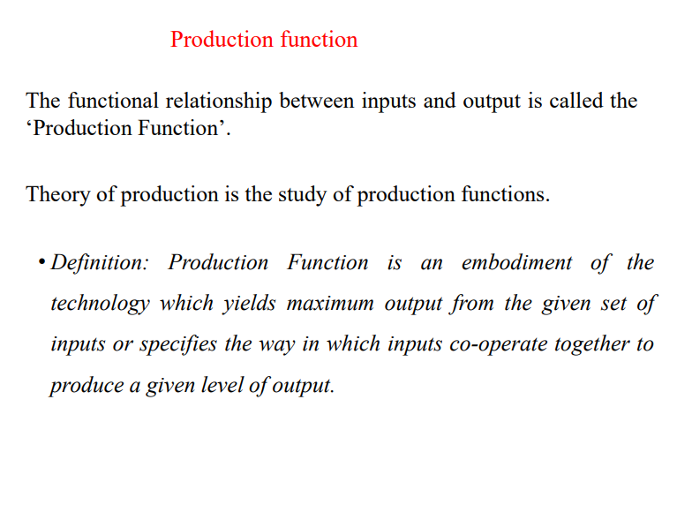

Slide 5
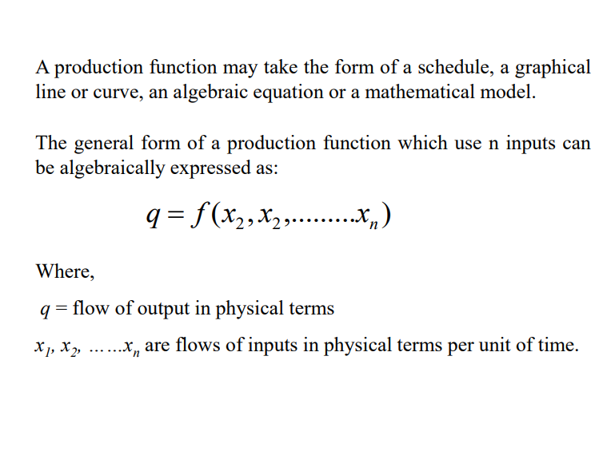

Slide 6
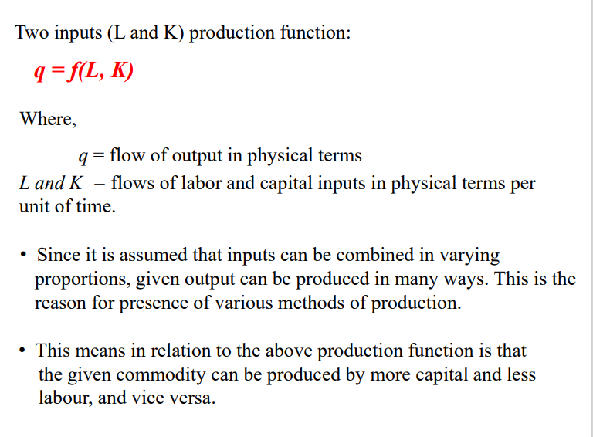

Slide 7
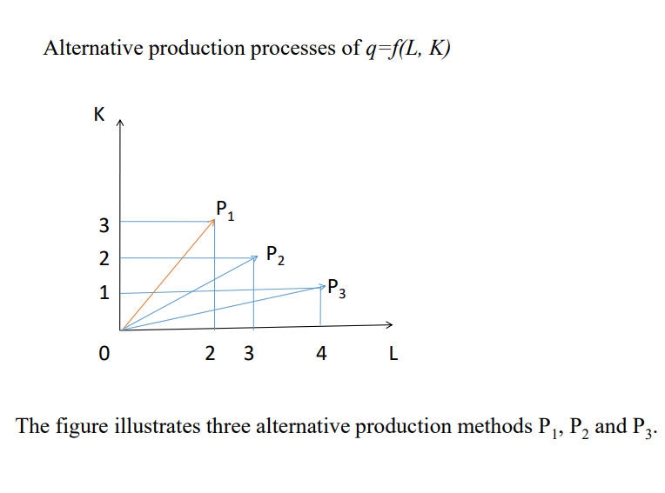

Slide 8
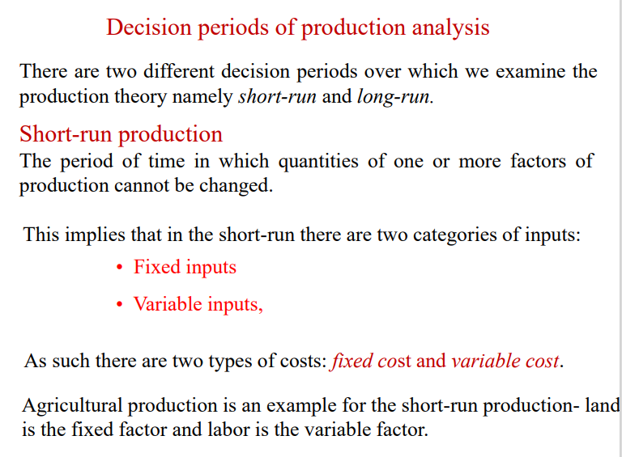

Slide 9
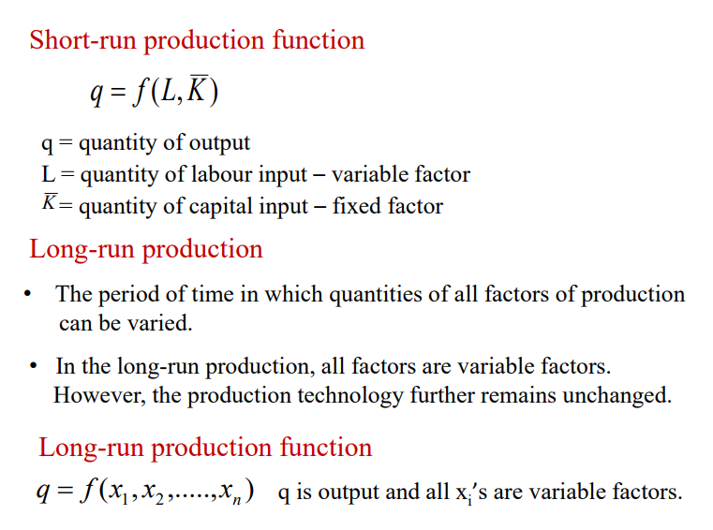

Slide 10
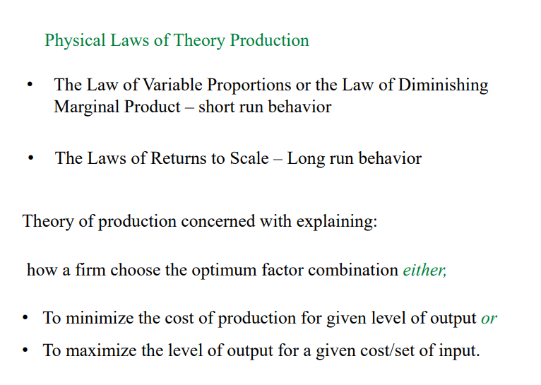

Slide 11
SHORT RUN
PRODUCTION FUNCTION (CON’T)
TOTAL PRODUCT (TP)
The amount of output produced when a given amount
of that input is used along with fixed inputs.
AVERAGE PRODUCT (AP)
Divide the total product by the amount of that
input used in the production.
Average Product (AP) = Total Product
Total Labour
AP = TP/ L

Slide 12
MARGINAL PRODUCT (MP)
Change in the total product of that input corresponding to
an additional unit change in its labour assuming
other factors, that is, capital fixed.
Marginal Product (MP) = Change in Total Product
Change in Total Labour
MP = Δ TP/ Δ L
SHORT RUN
PRODUCTION FUNCTION (CON’T)

Slide 13
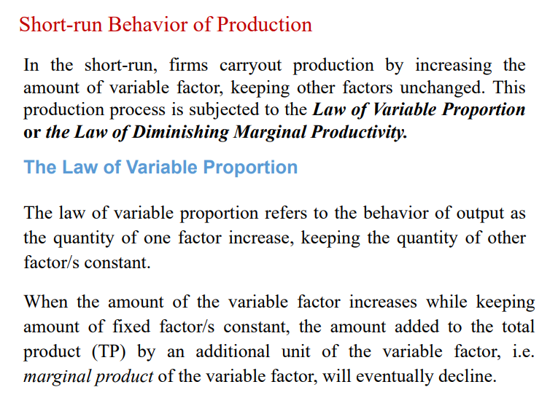

Slide 14
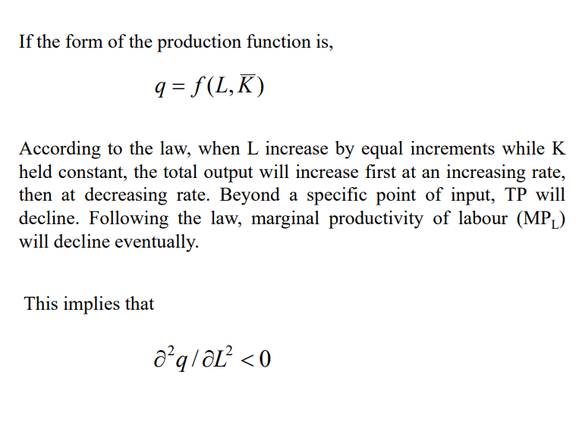

Slide 15
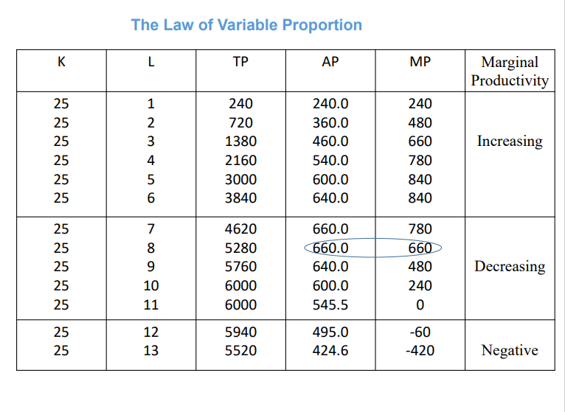

Slide 16
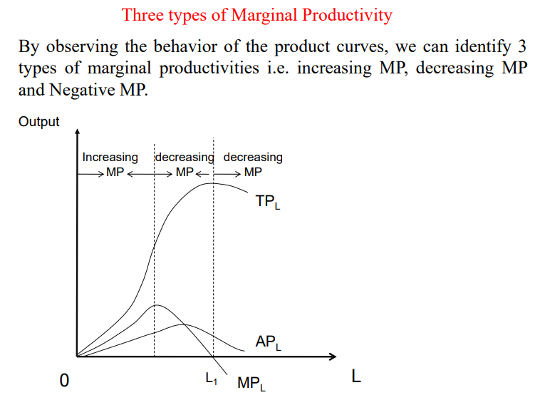

Slide 17
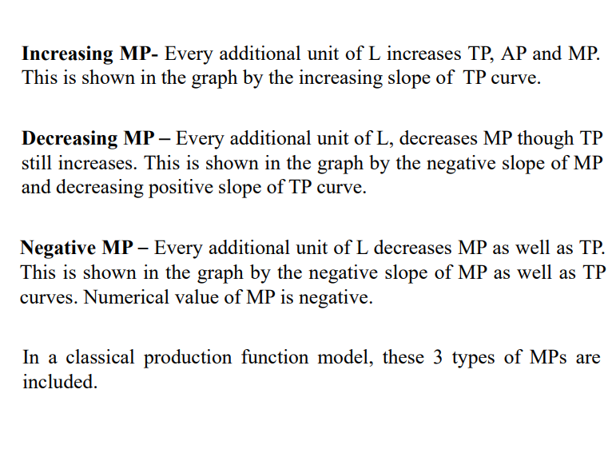

Slide 18
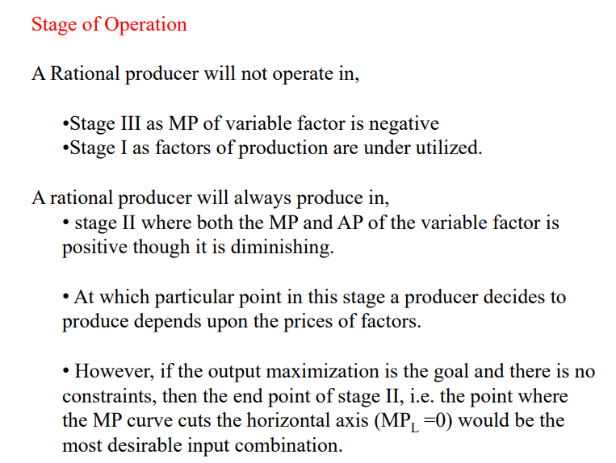

Slide 19
LONG-RUN
PRODUCTION FUNCTION (CON’T)
Isoquant
Isoquant represents all possible combinations of variable inputs that are used to generate the same level of output (total product).
Isoquant analysis illustrates that there are various ways to generate a given quantity of output in one time period.

Slide 20
LONG-RUN
PRODUCTION FUNCTION (CON’T)
Isoquant Table
CAPITAL
LABOUR
1
2
3
4
5
    1 250 450 600 700 800
    2 450 650 800 900 950
    3 600 800 950 1050 1100
    4 700 900 1050 1150 1200
    5 800 950 1100 1200 1250

Slide 21
SCALES OF PRODUCTION
DECREASING RETURNS TO SCALE
All the factors of production are increased in a given proportion, and output would increase by a smaller proportion.
CONSTANT RETURNS TO SCALE
All the factors of production are increased in a given proportion, and output would increase by the same proportion.
INCREASING RETURNS TO SCALE
All the factors of production are increased in a given proportion, and output would increase by a greater proportion.

Slide 22
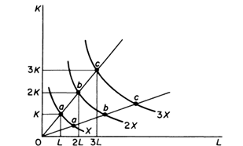
SCALES OF PRODUCTION (CON’T)
Constant returns to scale:

Slide 23
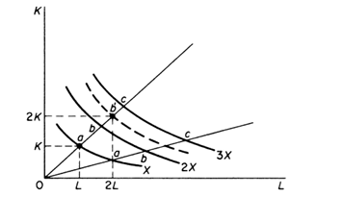
SCALES OF PRODUCTION (CON’T)
Increasing returns to scale:

Slide 24
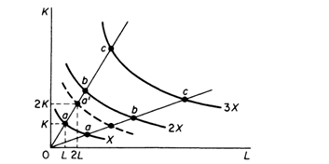
SCALES OF PRODUCTION (CON’T)
Decreasing returns to scale:

Slide 25
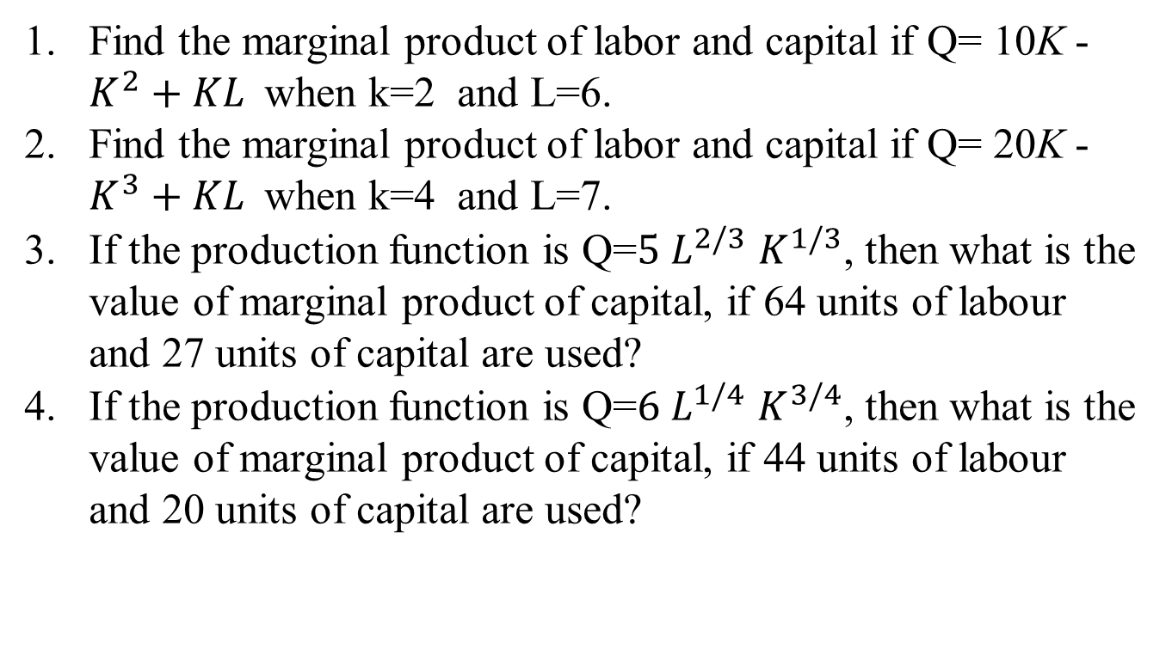
Mathematical Problems
Find the marginal product of labor and capital if Q= 10K -$K^{2}+KL$when k=2 and L=6.
Find the marginal product of labor and capital if Q= 20K -$K^{3}+KL$when k=4 and L=7.
If the production function is Q=${5 L}^{2/3}$ $K^{1/3}$, then what is the value of marginal product of capital, if 64 units of labour and 27 units of capital are used?
If the production function is Q=${6 L}^{1/4}$ $K^{3/4}$, then what is the value of marginal product of capital, if 44 units of labour and 20 units of capital are used?

Slide 26
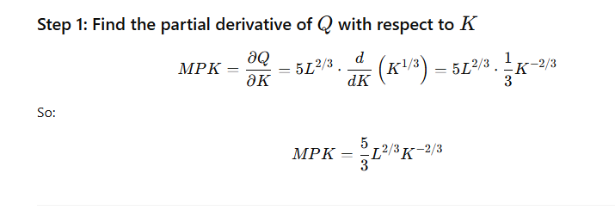
solution

Slide 27
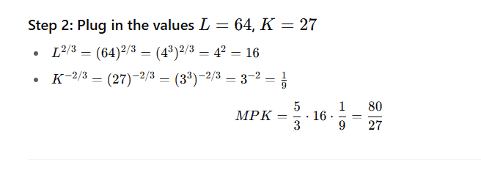
solution

